Slide 1
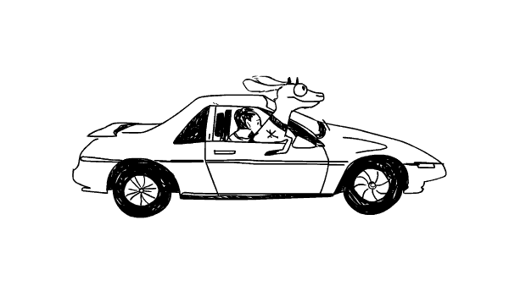
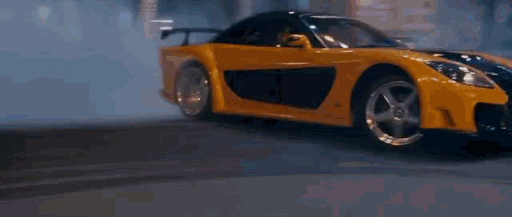
Driving Efficiency: Unveiling Insights into Automobile Performance

Slide 2
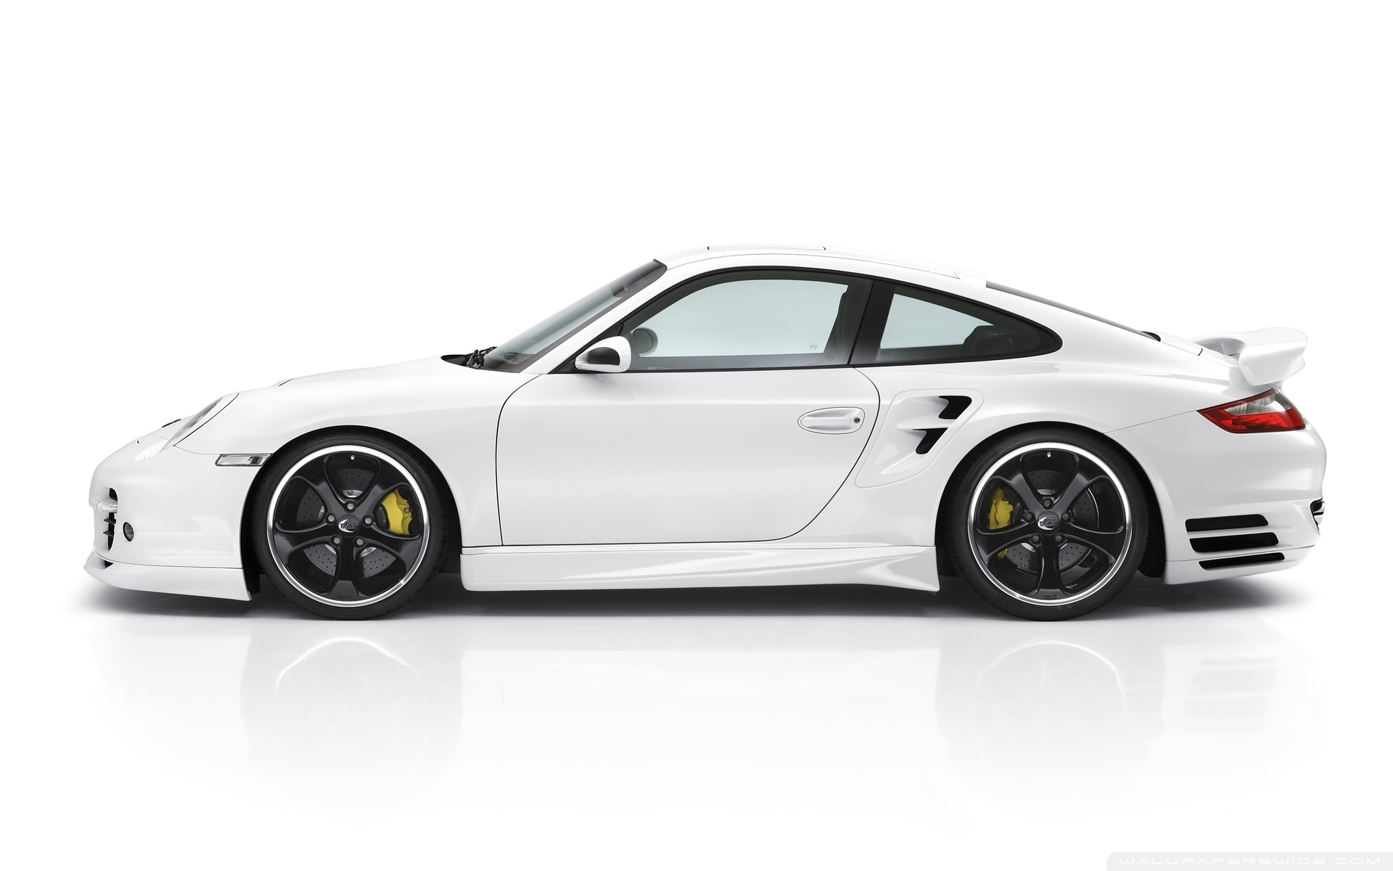
Table of Contents
Driving Efficiency: Unveiling Insights into Automobile Performance
Objective
Data Description
Data Insights
Final Thoughts
Appendix

Slide 3
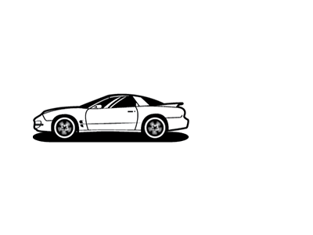
General Objective
How Mileage relates to Car Performance
Length
Body Styles
Brand
Specific Objective

Slide 4
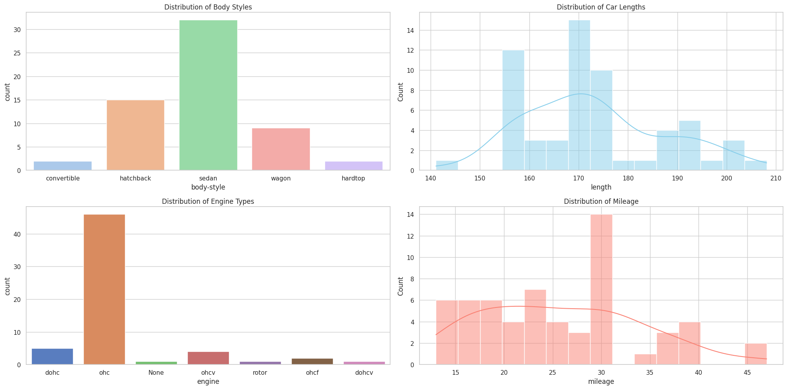
Data Description
1. Body Styles Overview:
- Illustrates the variety of body styles (convertible, hatchback, sedan, wagon, hardtop).
2. Car Length Distribution:
- range of car length, from 140 to 210 km/h.
3. Engine Type Spread:
- Displays engine types, including dohc and ohc.
4. Mileage Variation:
- Miles per Gallon
Source Github

Slide 5
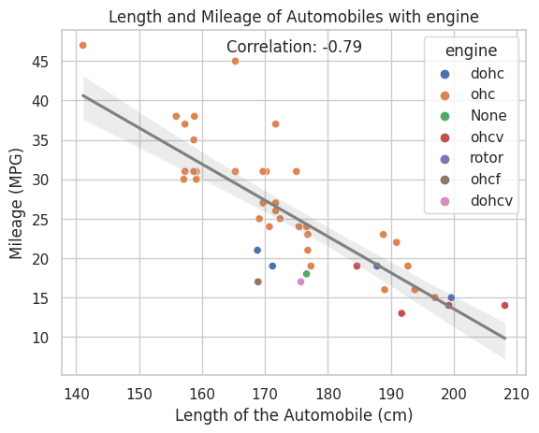
Data Insights
Engine,Length and Mileage
As the length of the automobile increases, the mileage tends to decrease.
As the length of the automobile decreases, the mileage tends to increase.

Slide 6
Length and Mileage Summary
For car buyers valuing fuel cost, smaller cars with engine type OHC mean better fuel efficiency. Those valuing space, comfort or specific needs may choose larger vehicles with lower mileage.

Slide 7
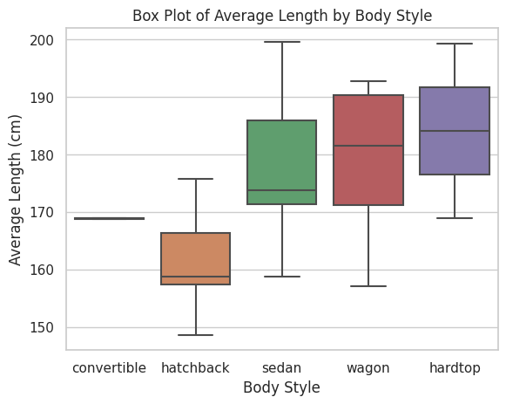
Body Style and Length
Hatchbacks: Compact size
Sedans/Wagons: Varied sizes
Convertibles: Medium length
Hardtops: Longer length

Slide 8
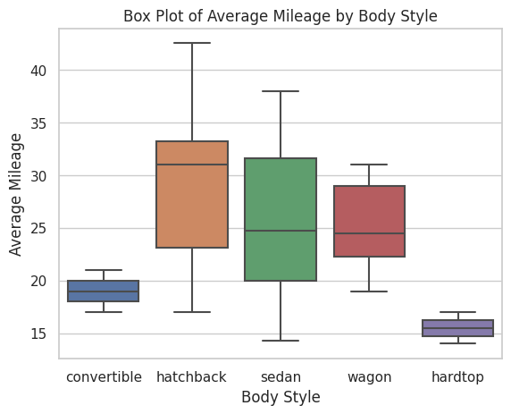
Body Style and Mileage
Hatchbacks: Good mileage(17-47).
Sedans/Wagons: Good mileage(13-38).
Convertibles: Good mileage(17-21).
Hardtops: Lesser mileage(14-17)

Slide 9
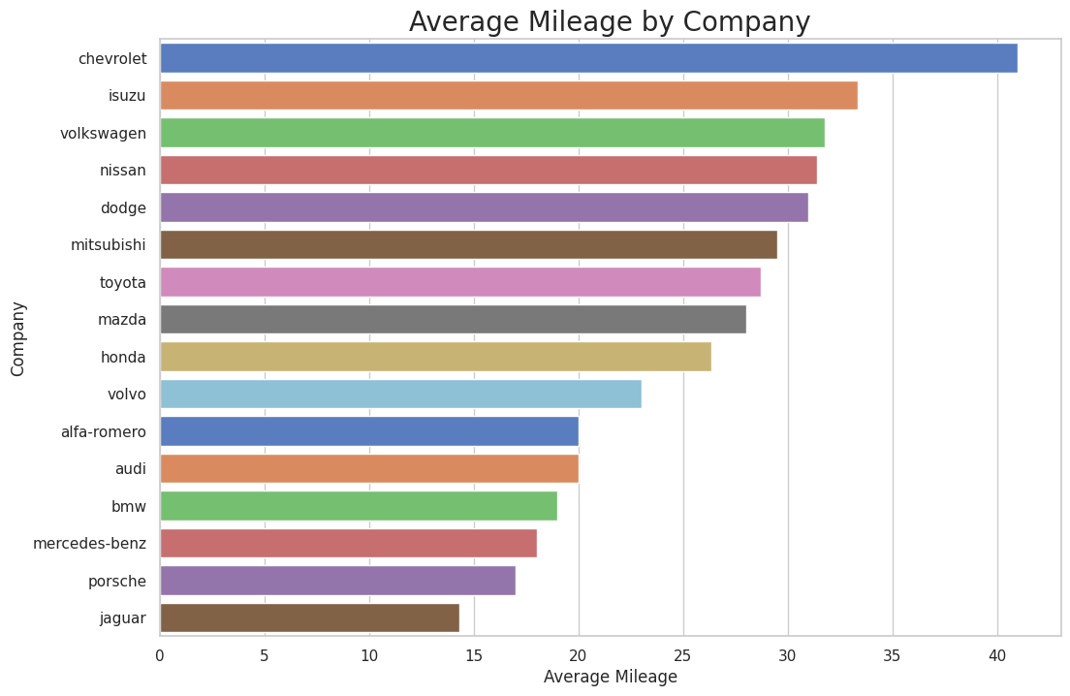
Company Brand
Chevrolet shines with a high 42, prioritizing fuel efficiency. Jaguars, at around 15, focus on unique performance features.

Slide 10
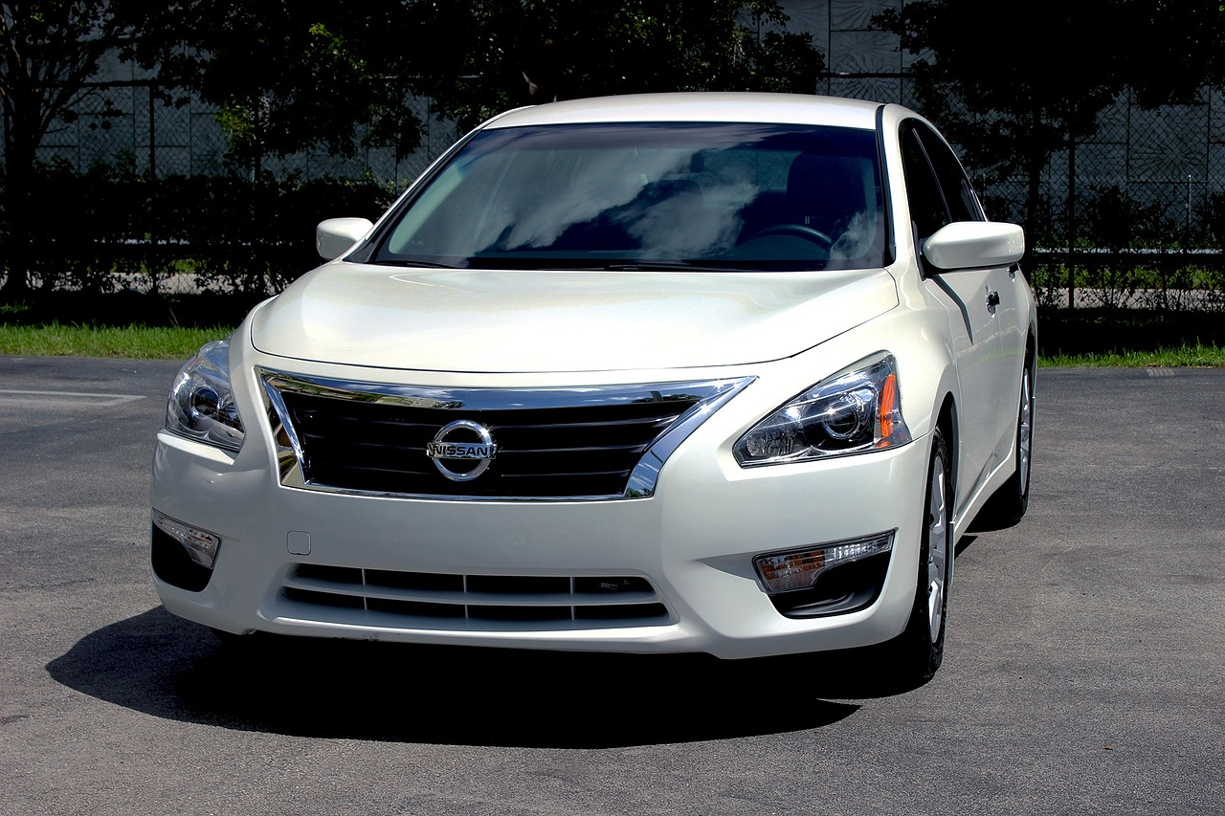
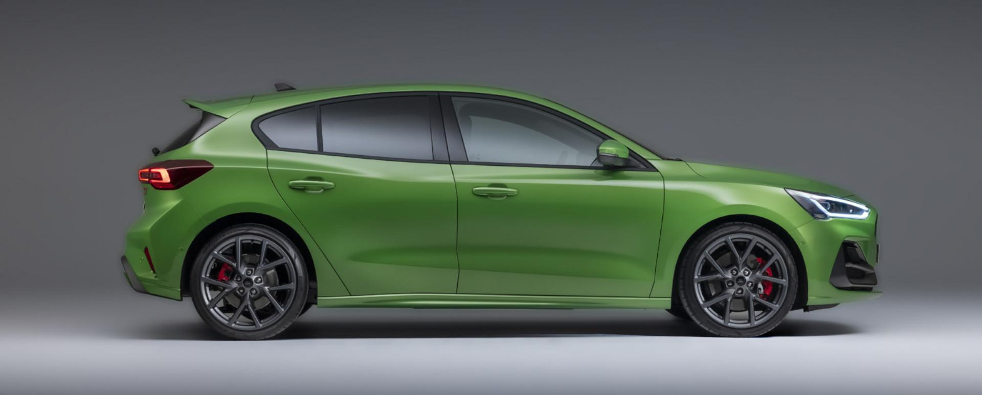
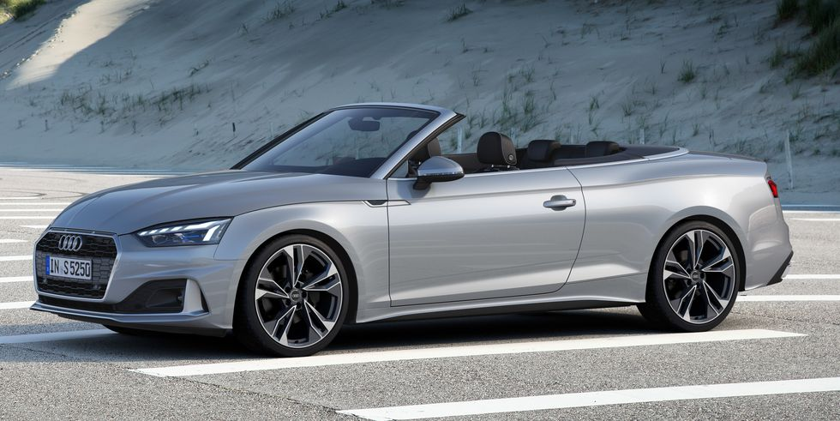
Final Thoughts
prioritize fuel efficiency by opting for smaller hatchbacks.
consider the balanced choice of sedans
explore convertibles and hardtops but sacrifice on mileage
FUEL EFFICIENCY
VERSATILITY
LUXURY

Slide 11
Thank you!

Slide 12
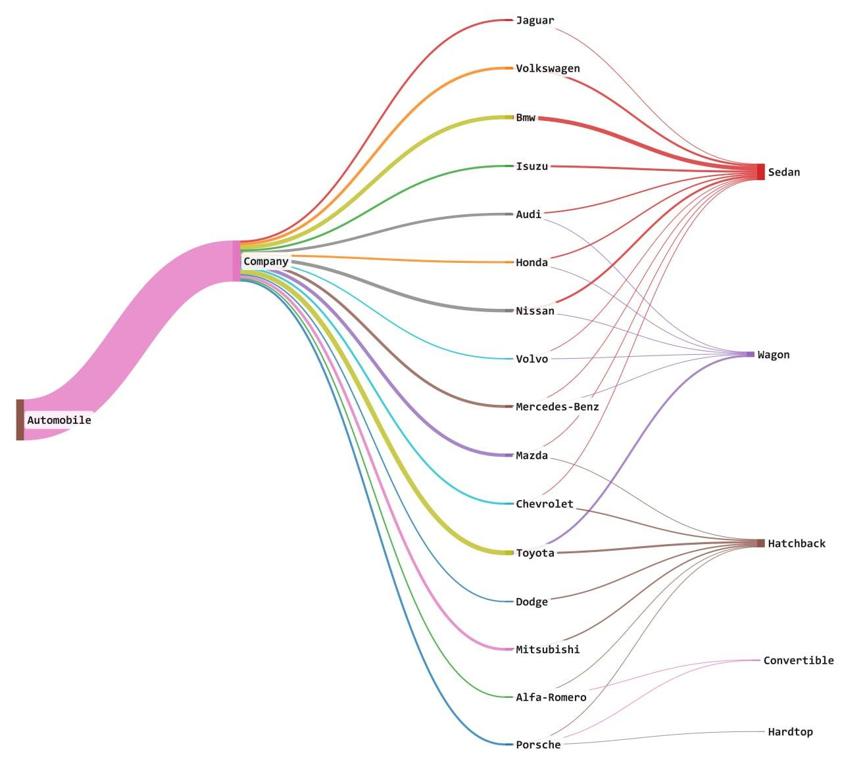
Appendix

Slide 13
Appendix
DOHC - (Dual Overhead Camshaft)
OHC- (Overhead Camshaft)
SOHC- (Single Overhead Camshaft)
OHCF (OverHead Camshaft Forward)
DOHCV (Dual OverHead Camshaft Variable)

